Slide 1

Social Trends - IncubateIND
Team Name: LAST KNIGHT CODERS
Team Leader: Shantanu Gupta
Team Member: Shantanu Gupta
Priya Saini

Slide 2

Description :
We build a website where anyone can see latest live trends of social sites by State-wise and country-wise.
We display analysis by graph and focus on UI/UX designing to attract visitors more and make easier to understand.
Possibilities to show and compare latest and trending #HASHTAGS.

Slide 3

Screen-Recording
Here, Complete site demonstration Screen-Record.
We Focused on UI/UX designing for users attract.
Next Page

Slide 4
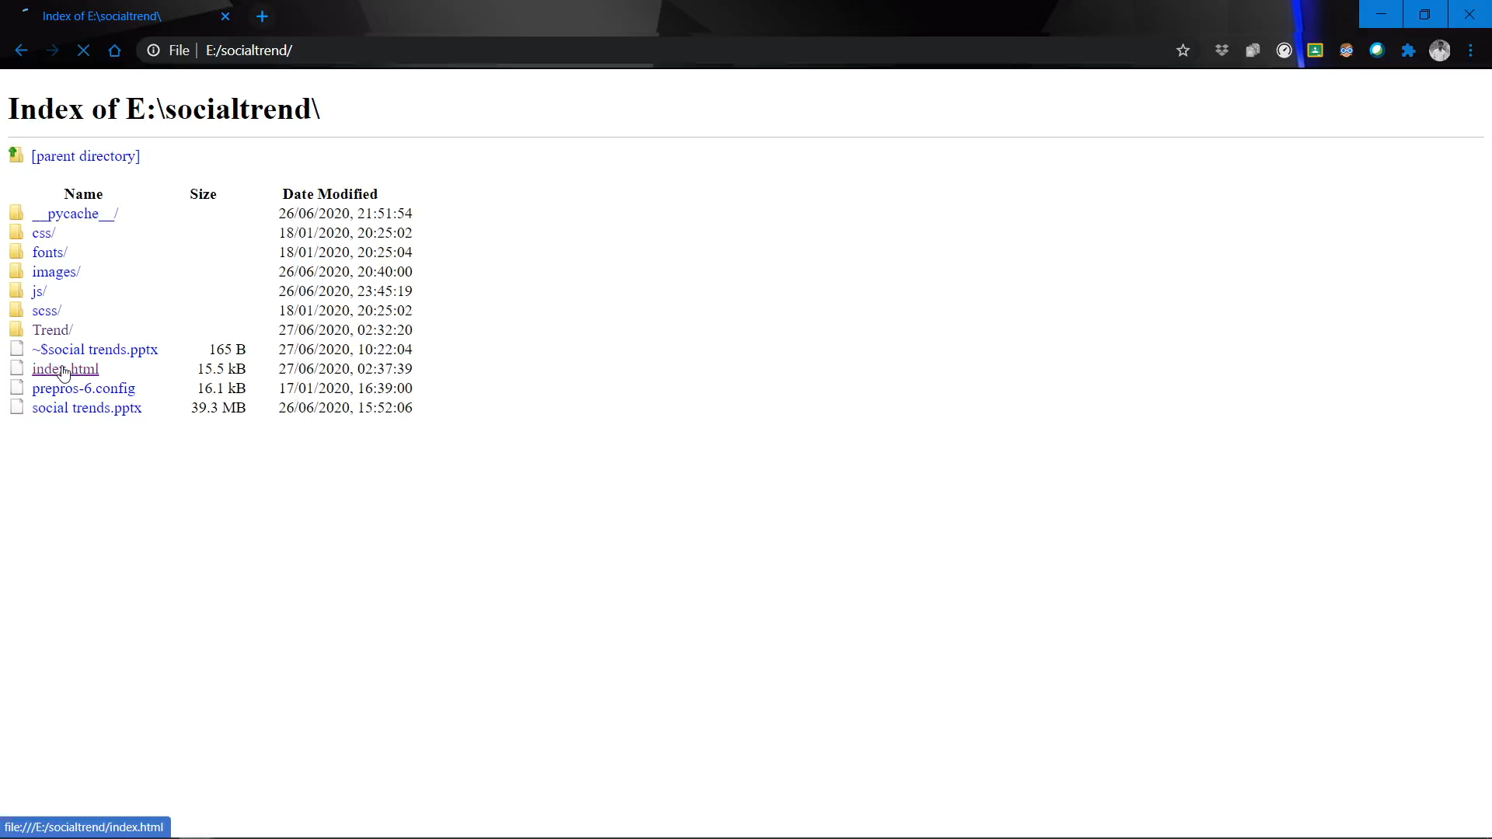

Slide 5

Technology Stacks:
Frontend / UI / UX:
HTML
CSS
bootstrap
Backend:
API (Geolocation)
JavaScript

Slide 6

Dependencies:
API Providers Admin Controller

